Slide 1
كلیة الھندسة - جامعة الزقازیق
الفرقة: الثالثة ھندسة الحاسبات والمنظومات
المقرر: دوائر الحاسب المتكاملة
الإسم: عبدالله محمد السيد حسين
رقم في السكشن:55
رقم الجروب وإسم الموضوع:
Group 5 - Digital Clock

Slide 2
Project
Digital clock
Displaying time & date

Slide 3
Main idea
We will use timer NE555 to generate square wave with frequency = 1 HZ and then connect it with Counter 74ls90 to count the time in seconds ,minutes and hours and then connect it with 74ls47 decoder to convert time from binary to decimal (BCD) and then connect the decoder with 7-Segment common anode
To display the time on it

Slide 4
Task
Simulations & Using Am&pm

Slide 5
Making a digital clock with am & pm
This idea will be done using JK-Flip Flop
Jk flip flop stores 1-bit on Q and and vice versa on
First lets see the construction & Truth Table of jk flip flop

Slide 6
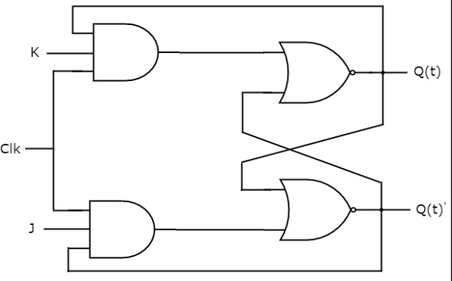
Image

Slide 7
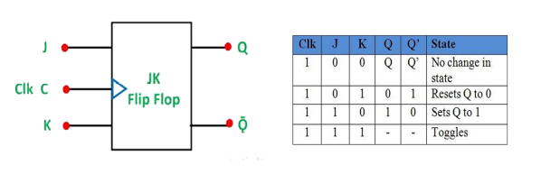
Truth table

Slide 8
JK Flip Flop
jk flip flop change its state depending on input But on the condition that there is a rising edge clock ( value change from 0 to 1 ).

Slide 9
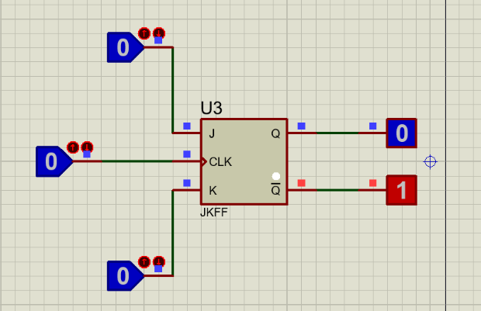
if j=K=0 and rising clock there will not be any change in the value of Q.

Slide 10
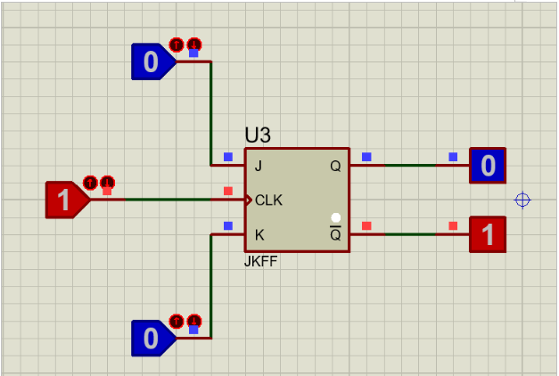

Slide 11
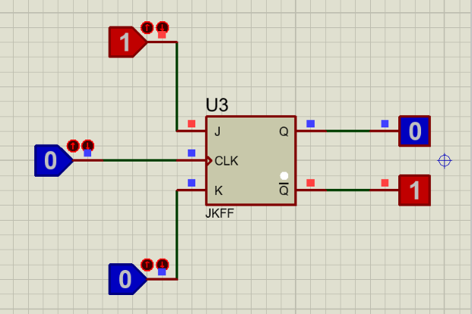
if j=1 and k=0 and rising clock this will set the value of Q to 1.

Slide 12
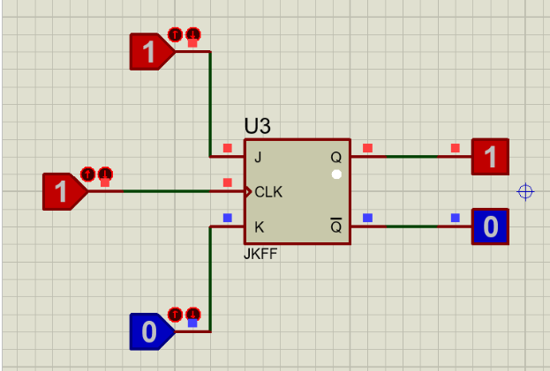
CON>

Slide 13
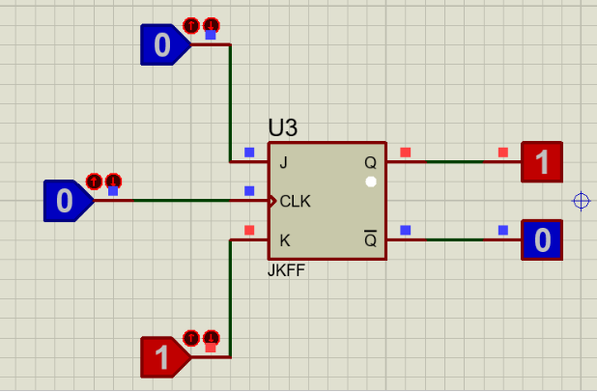
if j=0 and k=1 and rising clock this will reset Q to 0.

Slide 14
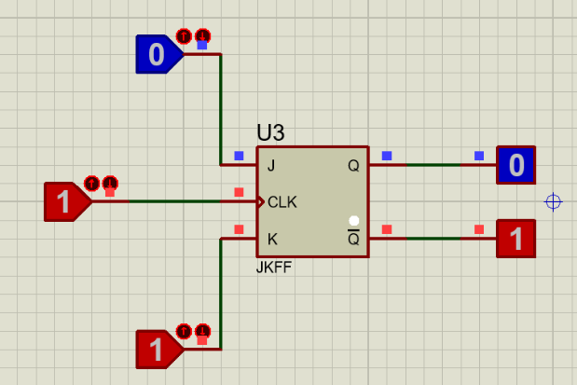
CON>

Slide 15
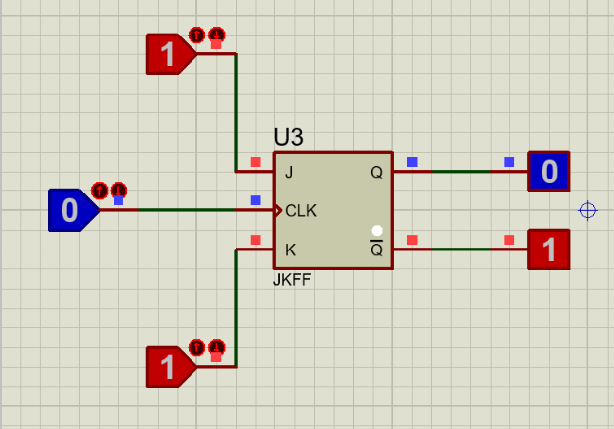
if j=k=1 and rising clock this will toggle Q
If Q=0 will be changed to 1 and vice versa.

Slide 16
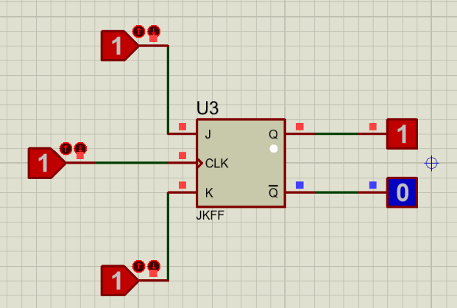
Proteus Image

Slide 17
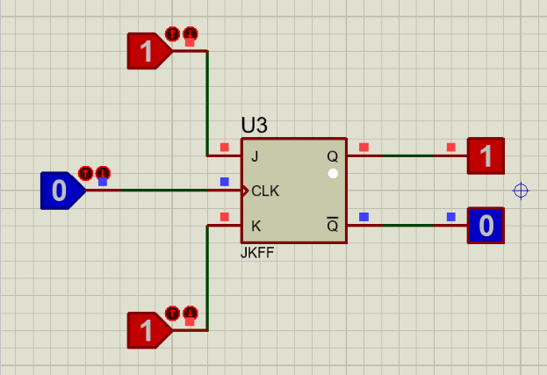
Proteus Image

Slide 18
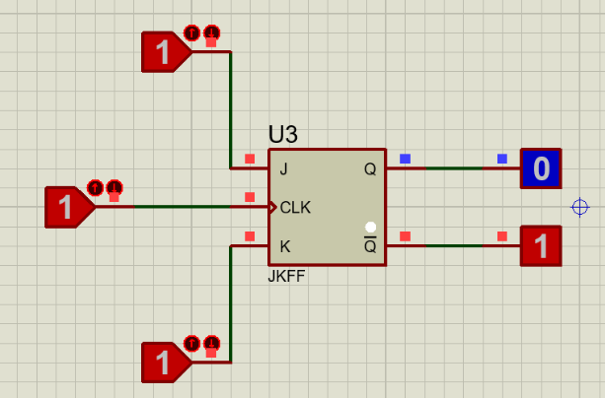
Proteus Image

Slide 19
Design
in our design we will use the case of toggle only

Slide 20
How to use jk flip flop to make am and pm
using jk flip flop and connecting two leds with it
one led for Am connected to and the other for Pm ,connected to Q.
the led will be illuminated every 12 hours.
So we need to get rising edge every 12 hours to toggle leds
To ensure case of toggle we will connect j and k with vcc.
To get an rising edge we will connect clk with AND gate and the two terminals of and gate will be connected to the two counters of hours.

Slide 21
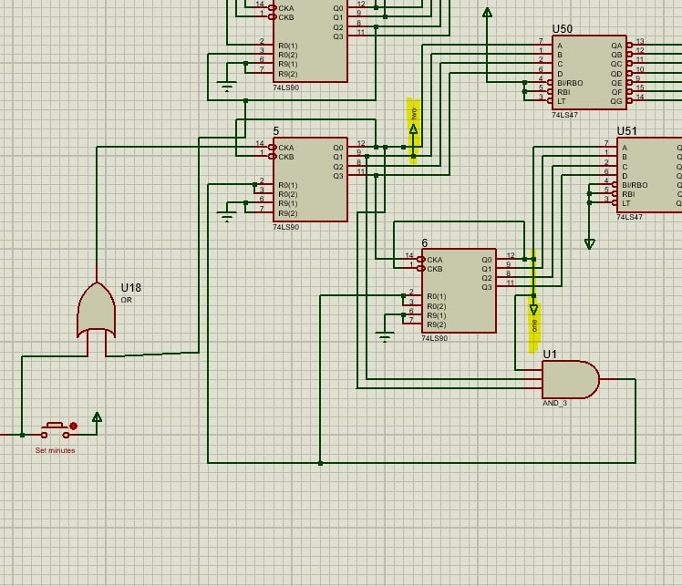
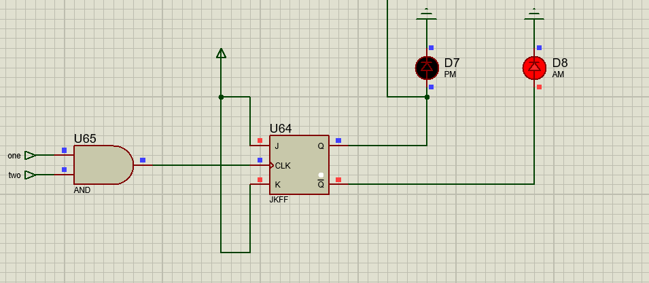
from design

Slide 22
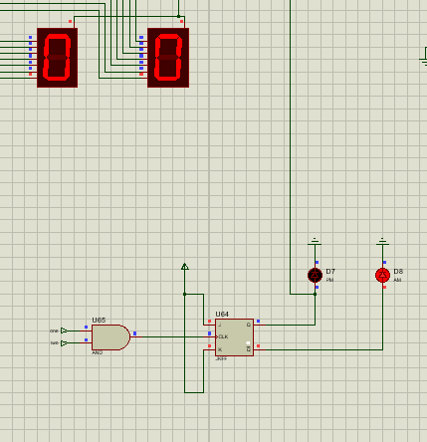
First the value of Q=0 as there is no input so the AM led illuminated

Slide 23
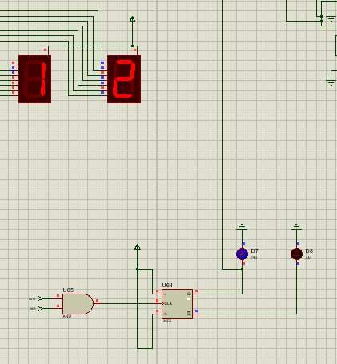
When rising edge clock occur after 12 hour Q=1 so the PM led illuminated

Slide 24
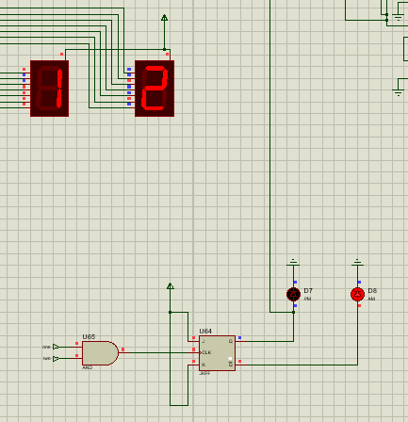
after next 12 hour Q=0 so the AM led illuminated

Slide 25
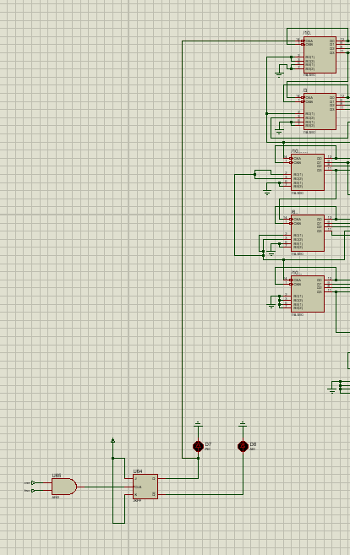
After 24 hours a signal will be passed to the counter of date to start count

